Slide 1
FIJI GIS & REMOTE SENSING
USER FORUM 2019 UPDATE
Notes:
Bula vinaka Everyone
As the secretary to the GIS&RS User forum, I will be presenting on the report for 2019

Slide 2
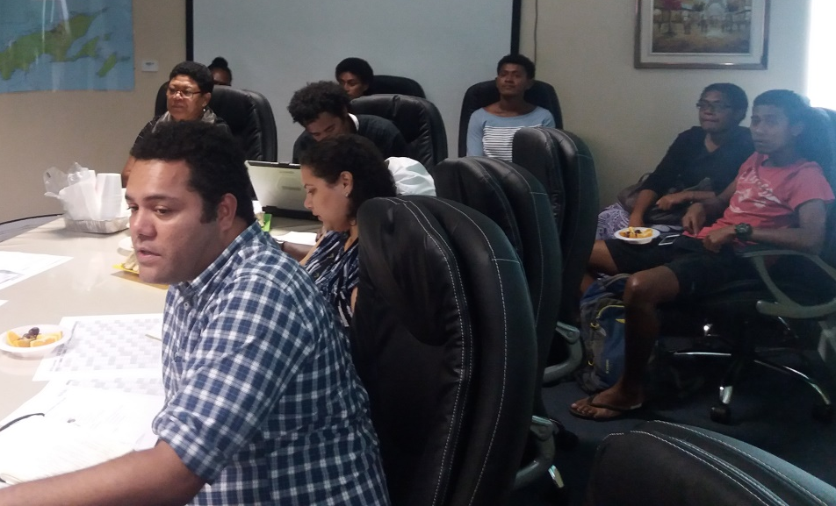
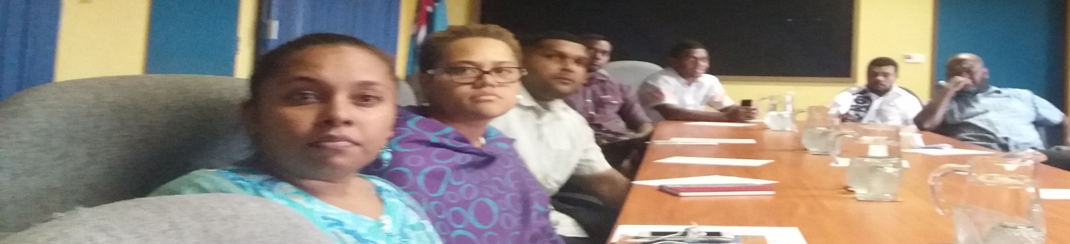
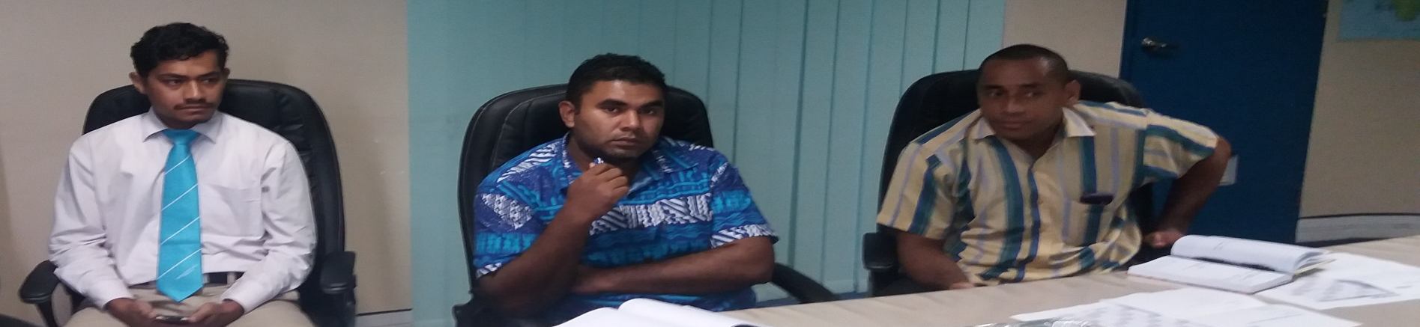
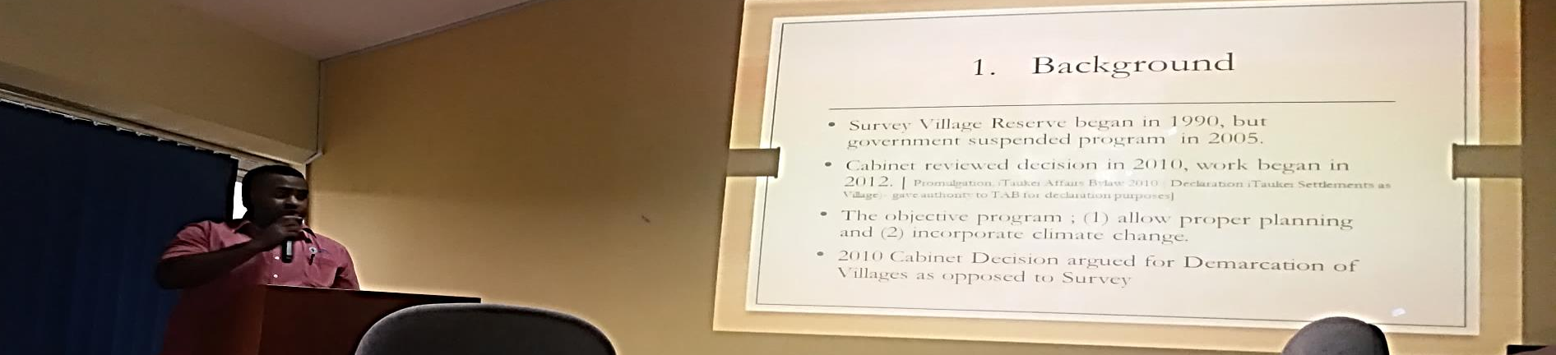
BACKGROUND
Notes:
Before I begin, just a brief introduction of this forum
The Fiji GIS & Remote Sensing User forum is a meeting space for the grass root GIS & RS Users to discuss various technical issues
The forum began in the early 90s with the first meeting held at the Forestry office as they and NLTB – at that time - were the only GIS units established.
FLIS was later established and incorporated into the forum
Ministry of Lands is the secretariat of the user forums (See February 2019 meeting – Wolf update) – arranging for host agencies, presentations and secretarial work
The forum Meets every 1st Tuesdays of the month

Slide 3
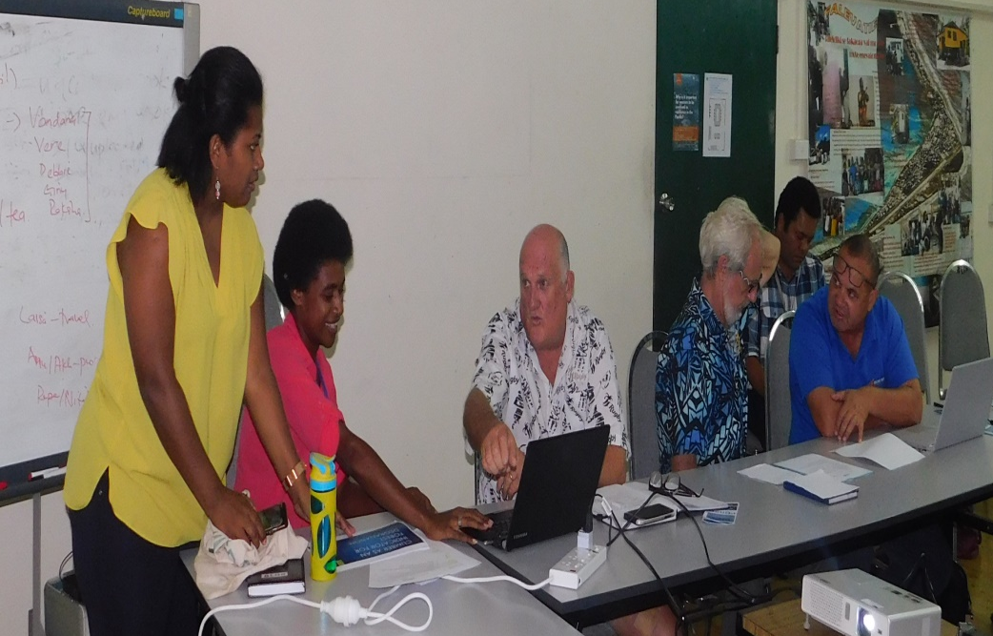
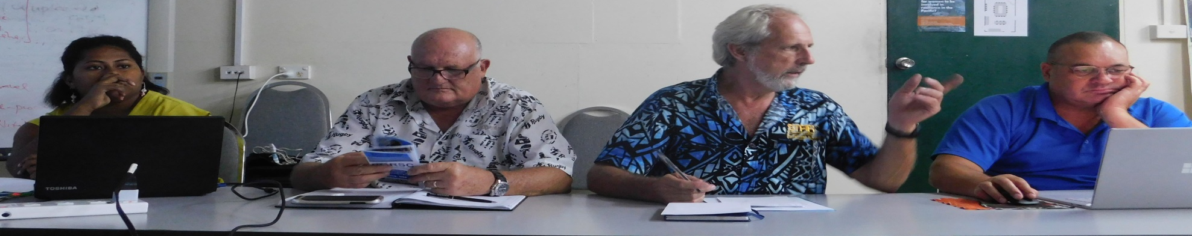
OBJECTIVE
NETWORKING
User & agency
updates
Presentations
Tech talk
Notes:
As mentioned earlier, the meetings are on the first Tuesdays of every month and we try to keep the meet as informal as possible
Main aim of the forum is to network
And where possible, find solutions and way forward for technical issues faced by users
Agenda is simple
The main purpose for the Agency updates;
1 so that there are no repetitive work
2 render assistance where possible from fellow agencies
Chair for each forum varies – encourage each host agency to chair
Presentations are of the different project currently undertaking or have been completed
Also, New to our agenda is the introduction of Tech talk

Slide 4
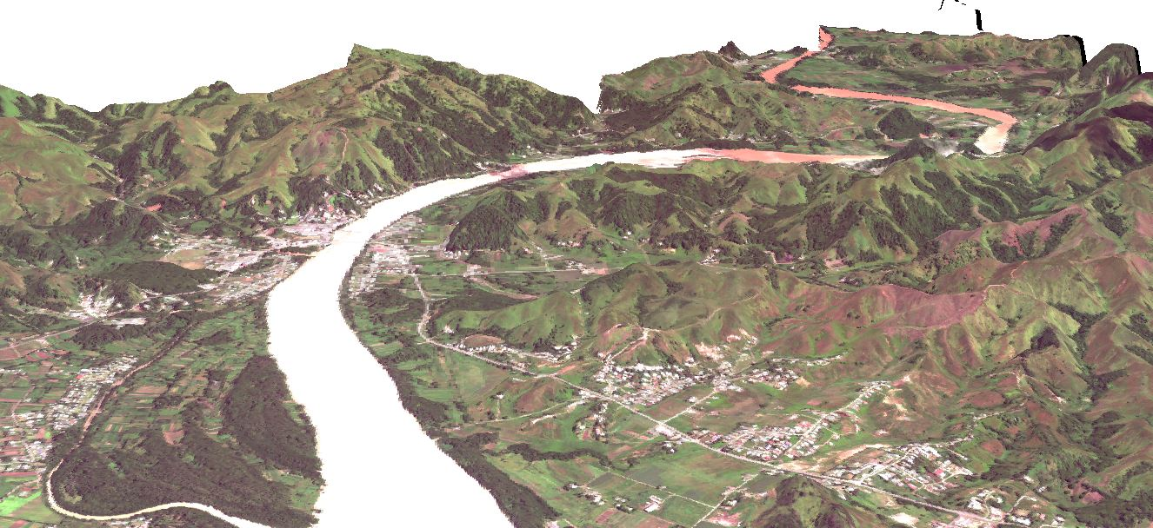
2019 Report
MONTH | HOST | ATTENDEES | TOPICS
February | Lands Dept. | 21 | Oceans App.
 |  | MRD, FEO, Lands, National Trust Fiji, FRA, Fiji Museum, USP | Disaster Response App.
 |  |  | Updating Land Information Using GIS
March | SPC | 20 | Digital Surface Model Establishment from Stereo Satellite Image Data for Fiji’s Sugar Belt
 |  | Drone Services, Lands, Pacific Flying Labs, USP, Min. of Women, Fiji Museum, Vodafone, FRA, MACBIO, SPC | Mangrove Mapping in Fiji Using WorldView Image Data and Google Earth Display
 |  |  | Historical Spatial Information Outside GIS
 |  |  | Climber as an Indicator for Forest Degradation
 |  |  | Nabukavesi Climber Data Collection Using UAV
 |  |  | Image Acquisition in Pix4D for Forestry Degradation
 |  |  | Fly Like A Girl Program 2019
 |  |  | Master Degree Geospatial Science at USP
Notes:
The following table is a report of the 2019 user forum broken down to month host attendees and presentation topics

Slide 5
2019 Report
MONTH | HOST | ATTENDEES | TOPICS
April | Mineral Resources Dept. | 14 | MRD Updates
 |  | MRD, Min. of Women, Drone Services, NDMO, DTCP, EFL, Lands | Mapillary - "Crowdsourced Geotagged" photos
May | Lands | 34 | Update on Fijis Geodetic Modernisation Program
 |  | Min. of Women, Min. of Rural & Maritime Development, Min.of Forestry, FiBoS, National Trust of Fiji, Lands, Min. of Infrastructure, FEO, SPC, Drone Services, MOD.NSOC Secretariat, FRA, Min.of Defence | Mapping of prominent Buildings in Fiji
 |  |  | Fiji Geospatial Information Management Strategy
 |  |  | Fiji Geospatial Information Management Council & Technical Advisory Council Updates
June | Host unavailability
July | TLTB | 16 | 3D Mapping of Prominent Buildings Update
 |  | Rural & Maritime, National Trust of Fiji, FRA, Lands, SPC, TFL, Min.of Forestry, MWCPA, EFL, TLTB, Min.of Defence | TLTB Update
August | Host unavailability

Slide 6
2019 Report
MONTH | HOST | ATTENDEES | TOPICS
September | FRA | 19 | CommonSensing Project Update
 |  | National Trust of Fiji, UN, Lands, Drone Services, TFL, FRA, FiBos, MRD, 3s Prospect, DTCP, Min.of Fisheries | MWCPA GIS Work Update
 |  |  | Global Fundamental Data Themes for Fiji
October | Agriculture | 26 | Eagle Technology Updates
 |  | Lands, Agriculture, Drone Services, MWCPA, Forestry, UNITAR, PGRSC, Eagle Technology (NZ), FRA, FiBoS, WAF | History of GIS & RS User Forum
 |  |  | 2020 -National Agriculture Census
November | Forestry | 14 | Forestry updates
 |  | Lands, TFL, MOIT, Min.of Forestry, FiBoS, TLTB | Forestry Drones project update

Slide 7
Notes:
We would like to place emphasis especially to the council member agencies to be a part of this user forum.
This graph shows the Regular attendees to the User group include;
Lands
National Trust of Fiji
FRA
MWCPA
SPC
Forestry
FIBOS
Drone Services FJ
*We would like to see more participation from the Council member agencies as we strive to work towards achieving the 5 goals of the Fiji Geospatial Information Management Strategy which is;
-Governance
-Data
-Access
-Interoperability
And Development

Slide 8
Issues Raised
Data accuracy and quality
Data sharing
Data directory
Cost sharing for workshops and trainings
Notes:
*Data accuracy & quality, standardisation and uniformity
*data sharing – agencies hesitant in sharing data
*Data directory – information catalogue metadata and custodian contact information
*Cost sharing or invites for trainings & workshops

Slide 9
Way Forward
User Forum Hosts
FEB | MAR | APR | MAY | JUN | JUL | AUG | SEPT | OCT | NOV
04/02 | 03/03 | 07/04 | 05/05 | 02/06 | 07/07 | 04/08 | 01/09 | 06/10 | 03/11
LANDS
User Forum Hosts
  Tech talks
  User Experience
  Agency updates
Notes:
Again, we encourage participation esp. from the council member agencies to be part of the forum
This forum establishes networks, as well as provide possible GIS solutions to technical problems
Tech talks – esp. those that have gone for trainings and workshops to be able to share a bit of what they have learnt
User experience – esp. on the different software used

Slide 10
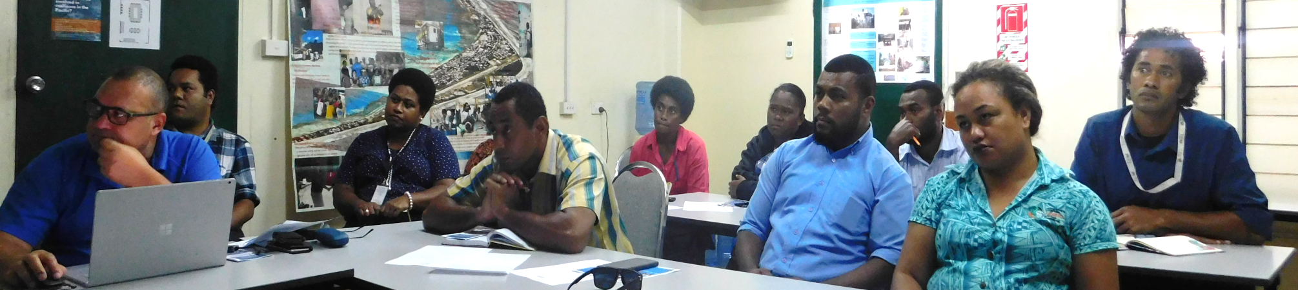
Vinaka
Notes:
Vinaka ladies and gentlemen, this concludes the GIS & RS User forum updates for 2019
* Again we entail agency hosts – for those interested to please let me know so I can pen your agency for the GIS & RS planner

